Slide 1
Advanced Car
Project Title:

Slide 2
Team Members:
Md. Al-amin - 2021200000088
Md. Raihan Shikder - 2021200000089
Md. Shahrear Mostofa - 2021200000060

Slide 3
Concepts
Purposes of the project
Features of the project
Future of the project
Three main parts of the project

Slide 4
Purposes of the Project

Slide 5
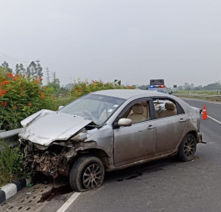
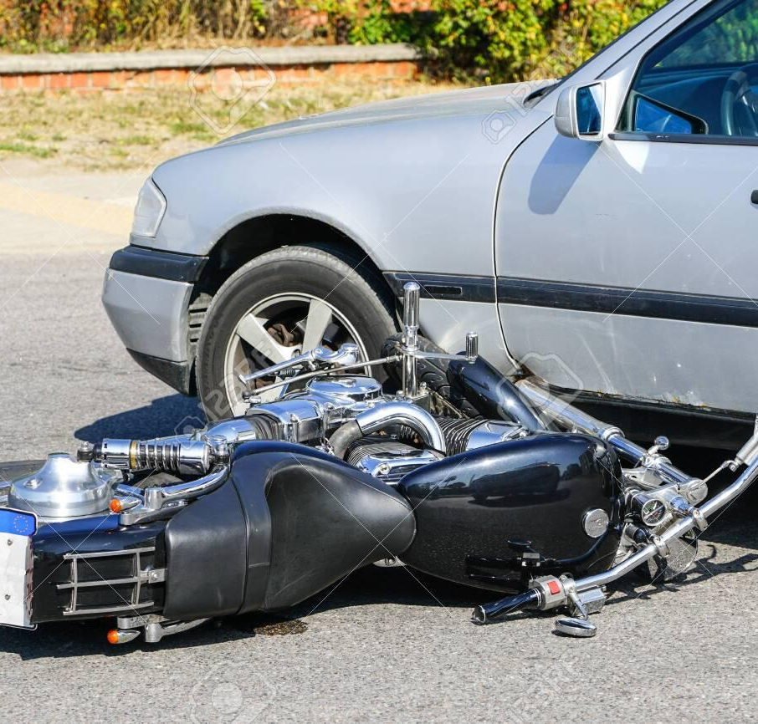
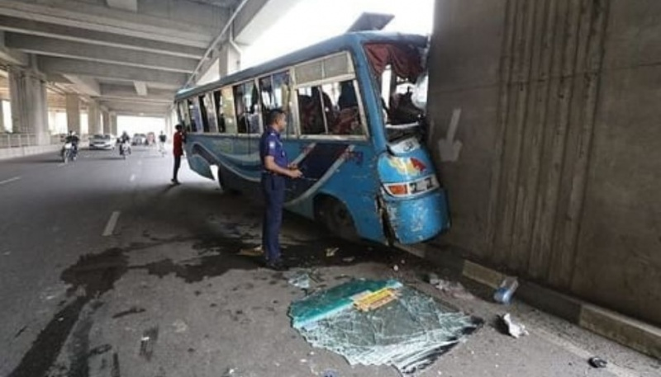
Road Accident Scenario:
In 2021, there were 5,629 accidents led to 7,809 deaths.
In 2022, there were staggering with at least 6,749 left 9,951 people dead.

Slide 6
Features of the Project

Slide 7
Features
Obstacle detection
Automated Brake/Reduce Speed.
Line/Lane Following
LED Indicator
Bluetooth Control with Mobile
Gesture Movements(Optional)

Slide 8
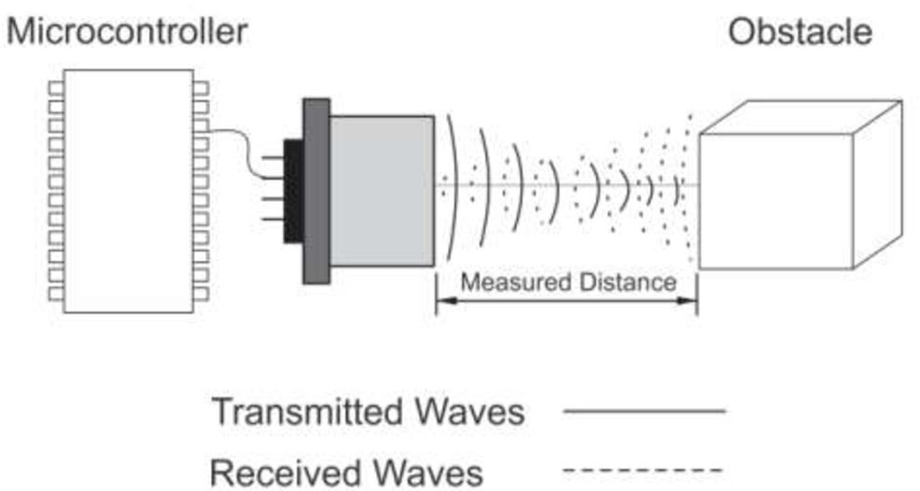
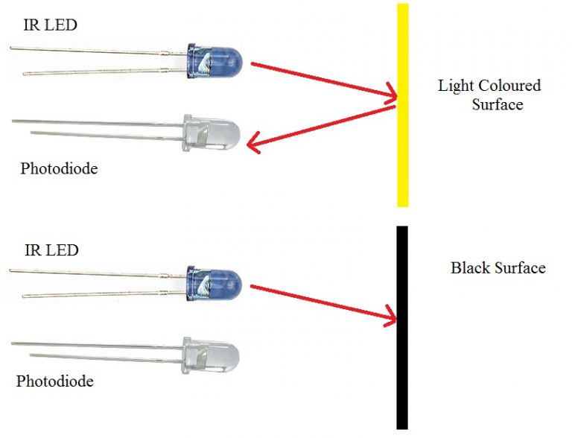
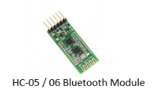
Obstacle Detection
Bluetooth Mobile Controller
Line/Lane Following

Slide 9
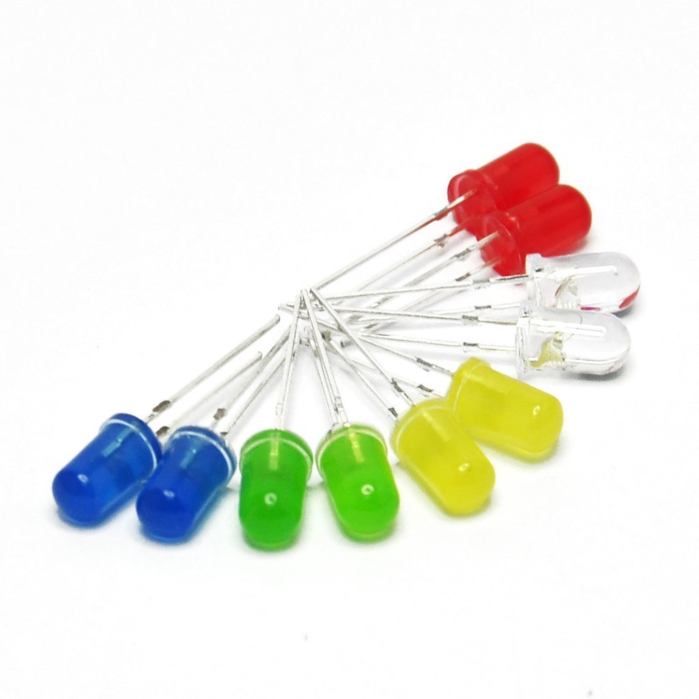
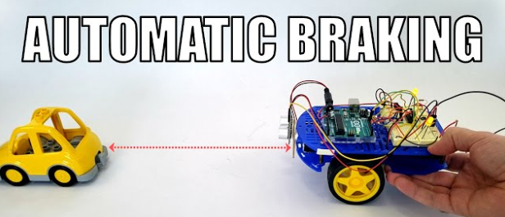
LED Indicator
Automated Brake System

Slide 10
Future of the Project

Slide 11
Future of this system
In today’s Bangladesh, accident case is very heard news. Daily many accident case came to us about speeding or overtaking and lake of braking system of vehicles. By using this system accidents can be prevent and people will be safe during driving. In future we can prosper in transportation system. Our system is not so expensive but very useful to everyone.

Slide 12
Thank You!

